Slide 1
YAM 2025
Much thanks to our county Art Teachers for encouraging such Fine Art from their students in the past year. Visual self-expression implies hope, happiness, resilience and empowerment.

Slide 2
Blue Ridge School - K-12 + Early College
Art Teacher: Amy Winston

Slide 3
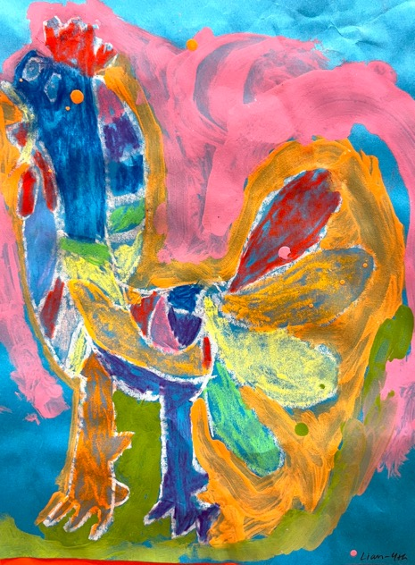
First Place-Liam Ferrin, 4th

Slide 4
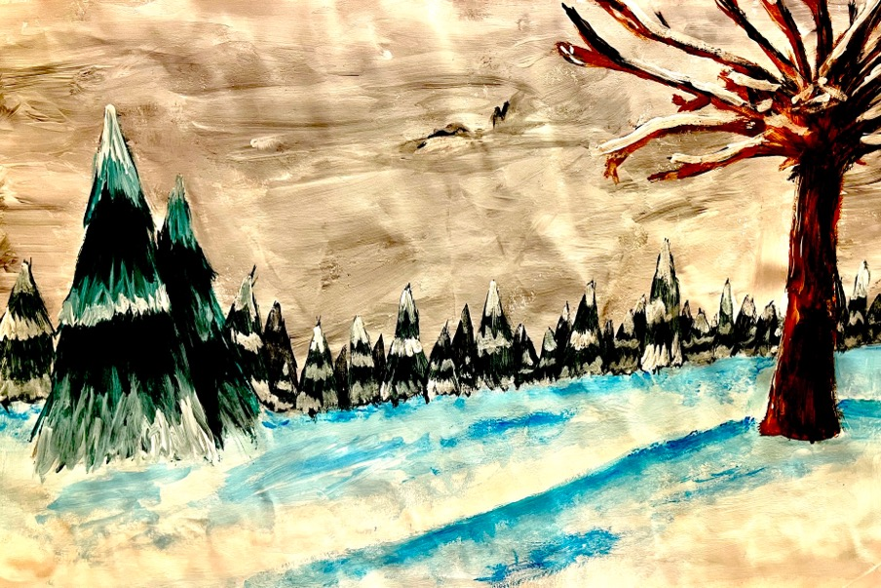
Second Place-Roxie McCall, 7th

Slide 5
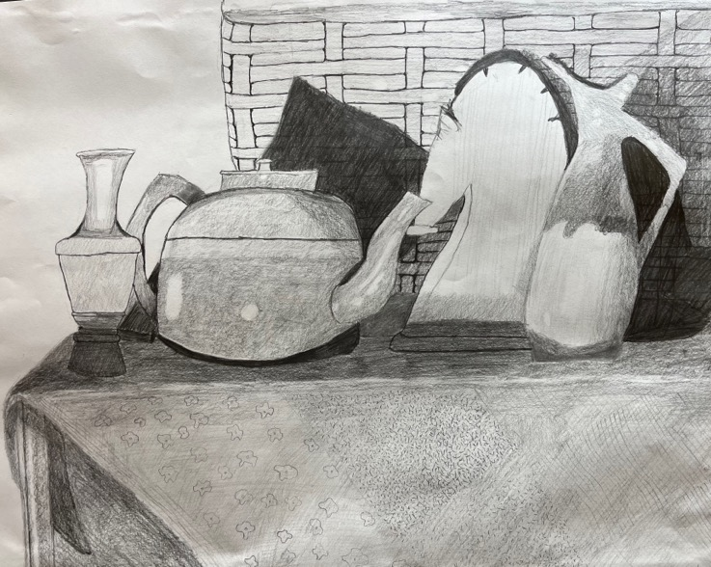
Honorable Mention-Max Ballentine, 12th

Slide 6
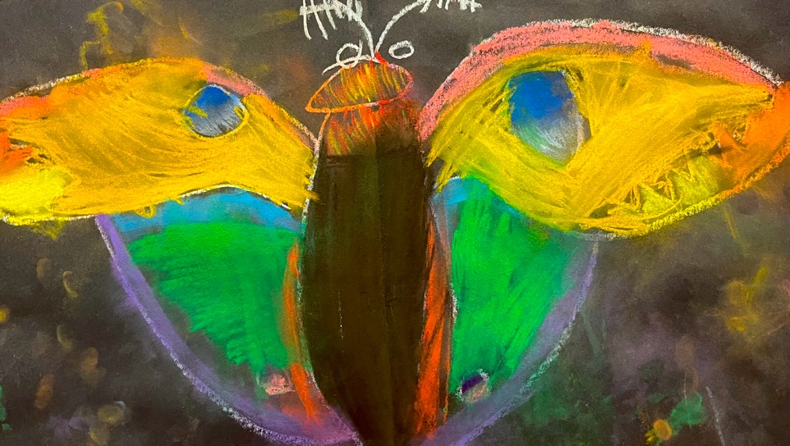
Honorable Mention-Katy Holden, K

Slide 7
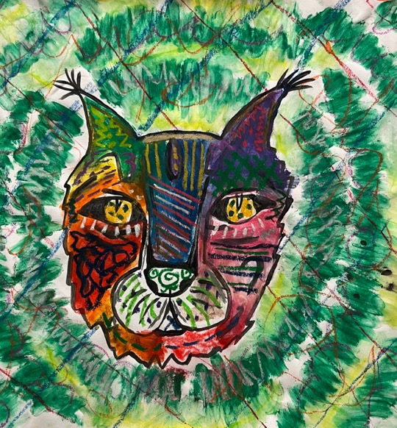
Honorable Mention –Rylee Sneed, 6th

Slide 8
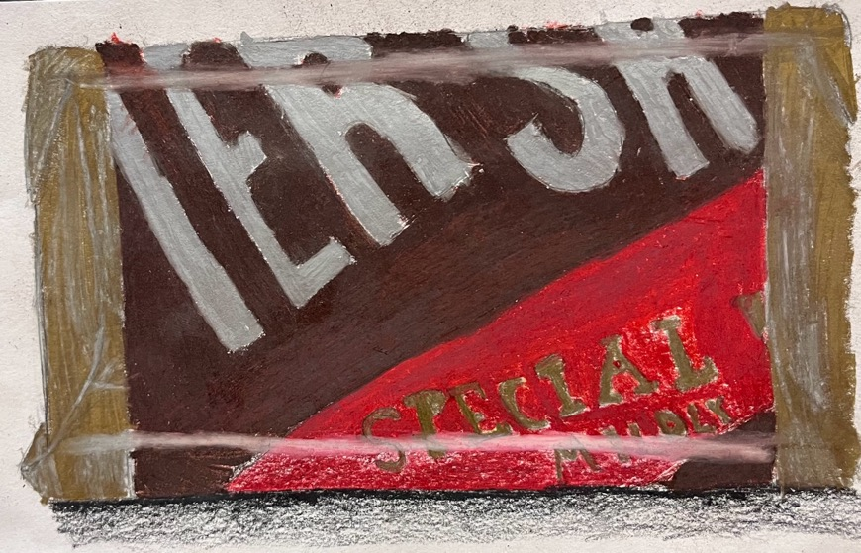
Honorable Mention –Christian Alcantar, 12th

Slide 9
Cullowhee Valley School
Art Teacher: Ms. Penelope Gobar

Slide 10
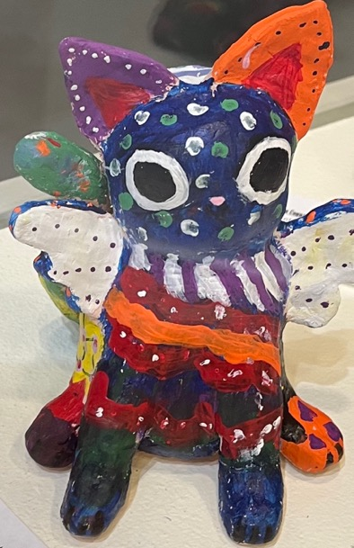
First Place-Amya Coke, 7th

Slide 11
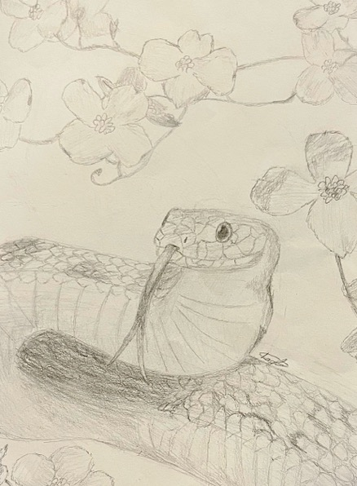
Second Place- Kayla Kopak, 8th

Slide 12
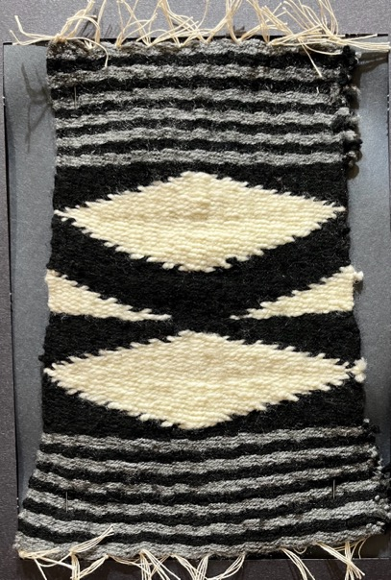
Second Place- Aries Lossiah, 7th

Slide 13
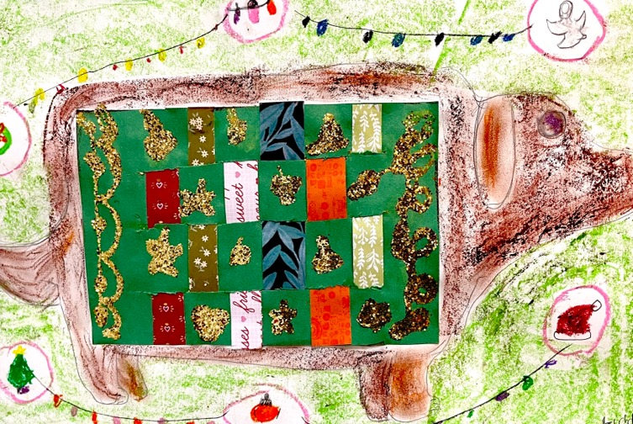
Honorable Mention-Liddie Crowe, 4th

Slide 14
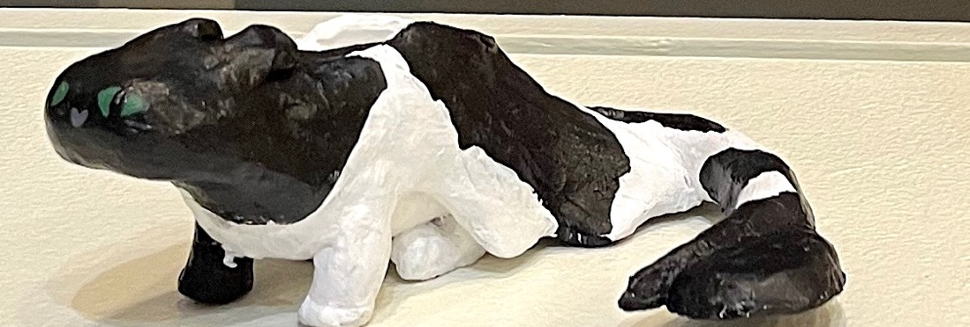
Honorable Mention-Skilerr Frady 8th

Slide 15
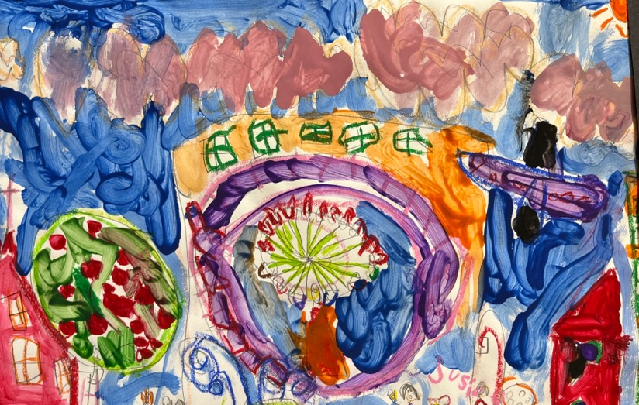
Honorable Mention –Susie Pedonti, 1st

Slide 16
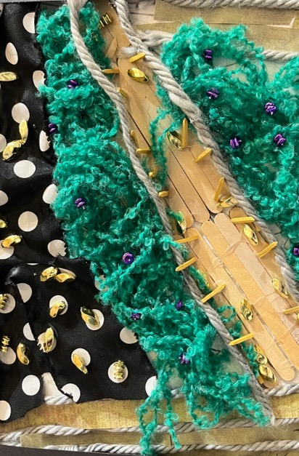
Honorable Mention –Mikaela Mercado Berrios, 5th

Slide 17
Fairview School
Art Teachers: Leigh Ayling & Autumn White

Slide 18
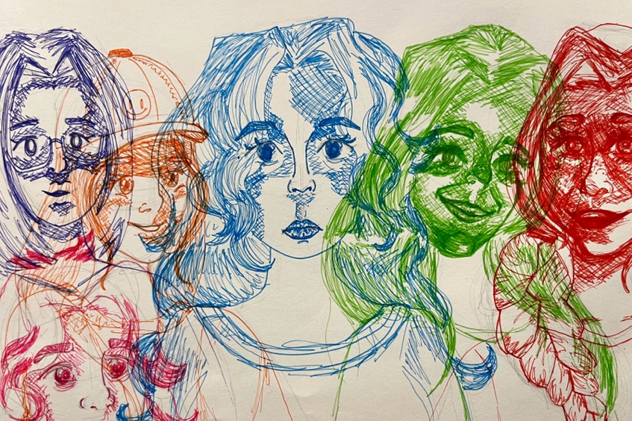
First Place –Natalya Wlosok, 8th

Slide 19
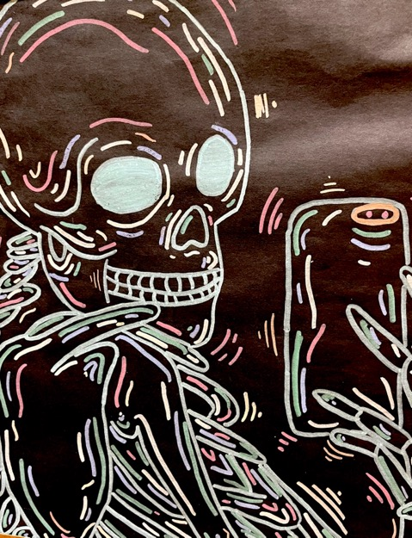
Second Place –Marley Parker, 7th

Slide 20
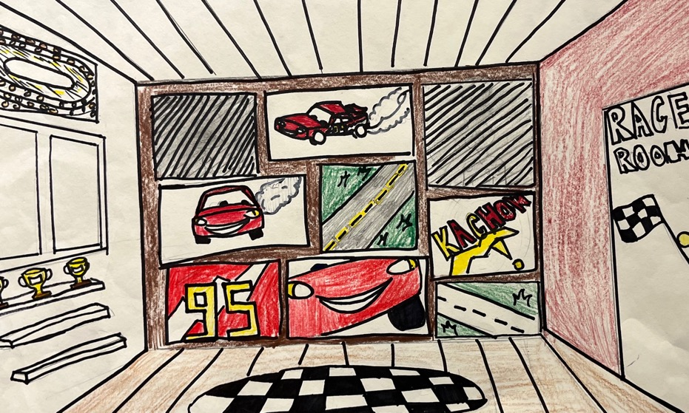
Honorable Mention-Zuri McBride, 6th

Slide 21
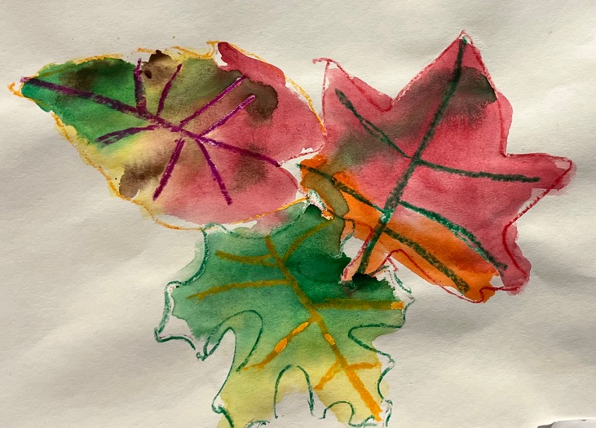
Honorable Mention –Ella Rickert, K

Slide 22
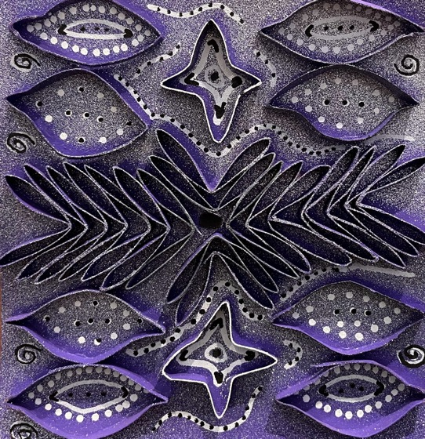
Honorable Mention –Hania Blitch, 7th

Slide 23
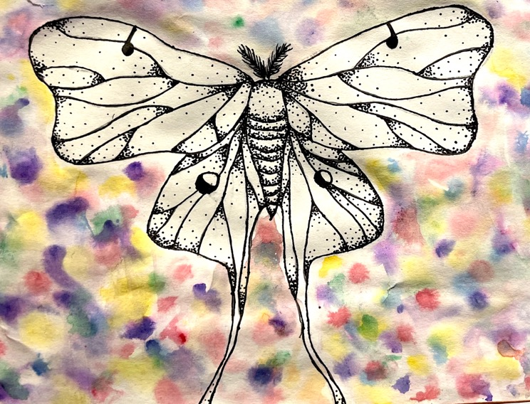
Honorable Mention –Penny Tissue, 6th

Slide 24
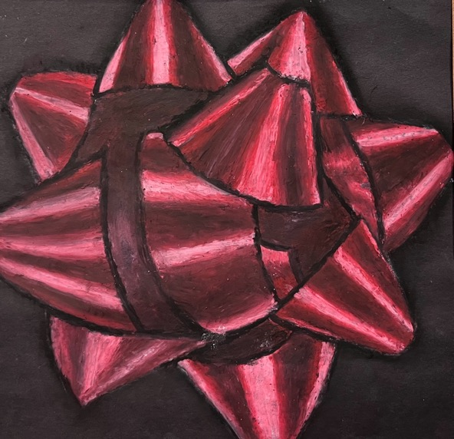
Honorable Mention –Lyra Fox, 8th

Slide 25
Jackson Community School
Art Teacher: Autumn White

Slide 26
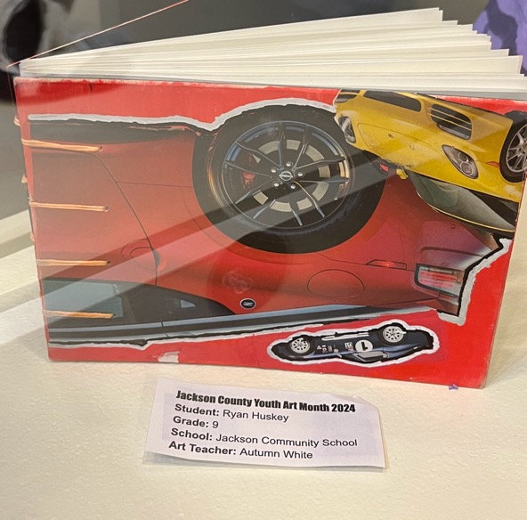
First place- Ryan Huskey, 9th

Slide 27
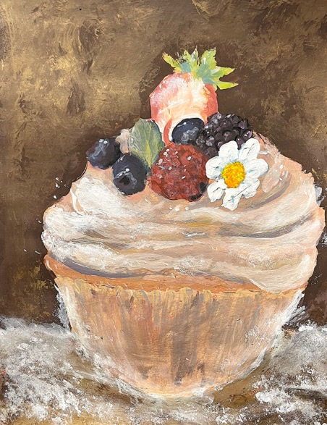
Second Place –Josephine Nelson, 9th

Slide 28
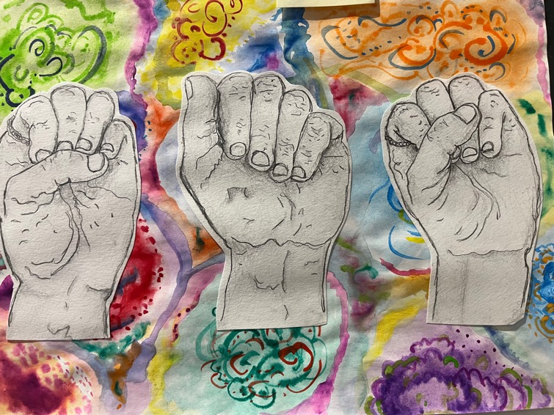
Honorable Mention –Elizabeth Stone

Slide 29
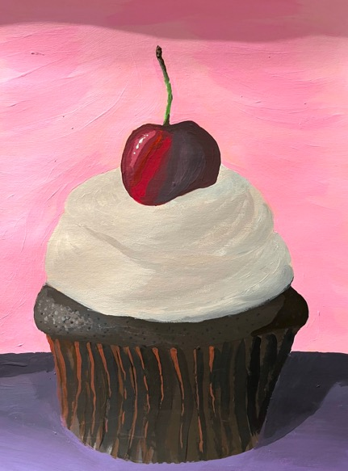
Honorable Mention –Jacob Lambert

Slide 30
Scott’s Creek School-
Art Teacher-Gabriela Evans

Slide 31
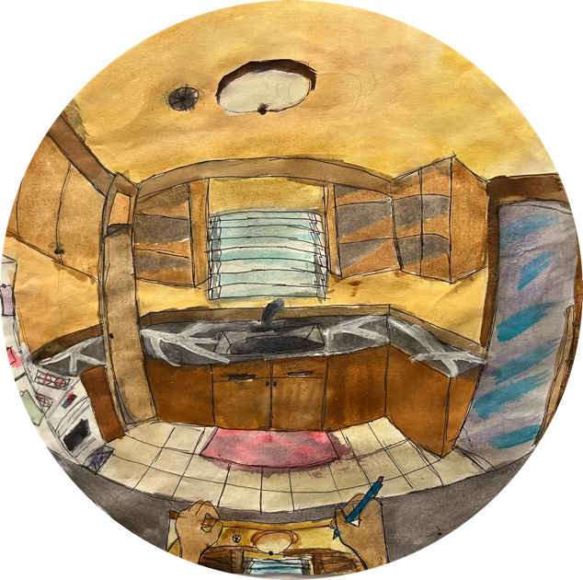
First Place- Layla Rivera, 8th

Slide 32
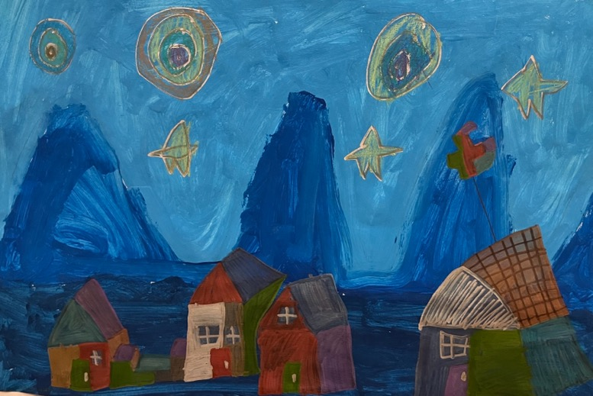
Second Place –CC Umphlett, 3rd

Slide 33
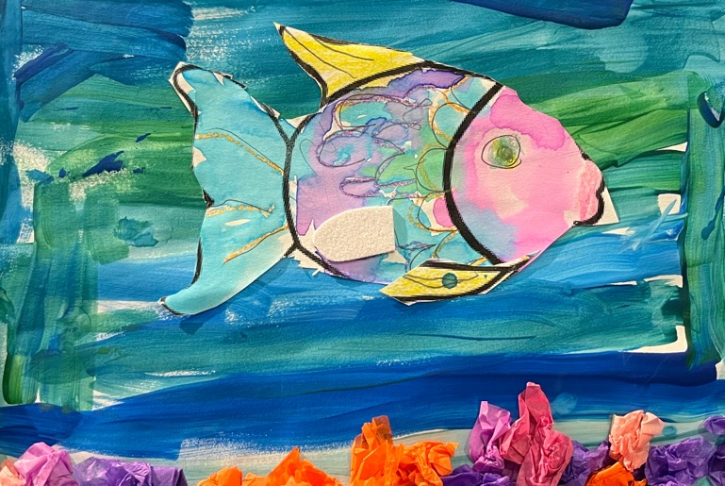
Honorable Mention-Myles White, K

Slide 34
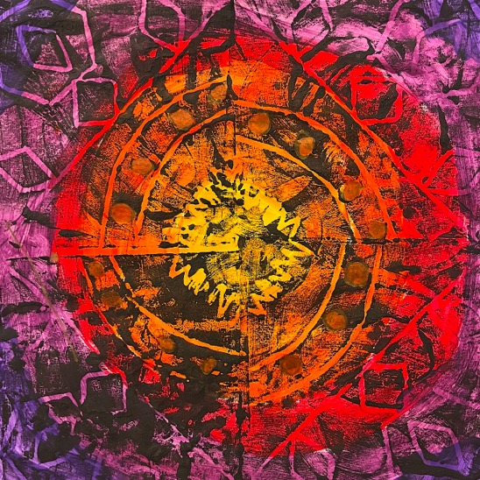
Honorable Mention- Walker Dowdle, 4th

Slide 35
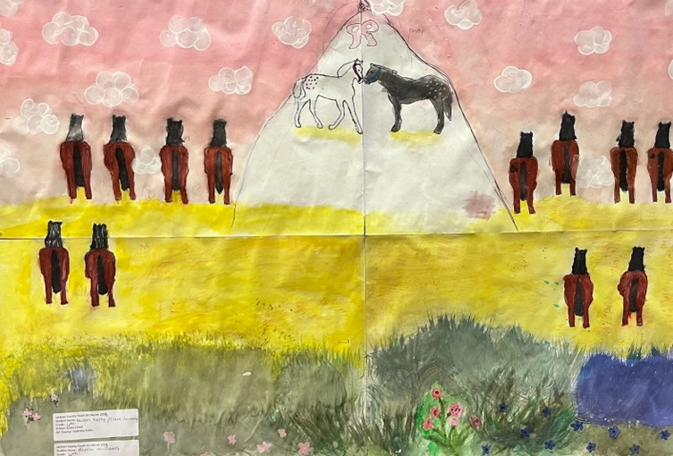
Honorable Mention –Harper Kelly, Ciara Lanning, Alyssa Williams, 6th

Slide 36
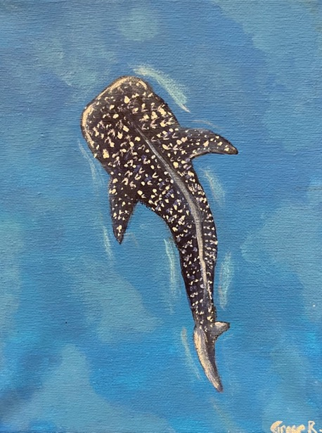
Honorable Mention –Grace Roth, 8th

Slide 37
Smokey Mountain Elementary School
Art Teacher: Jenniffer Dall

Slide 38
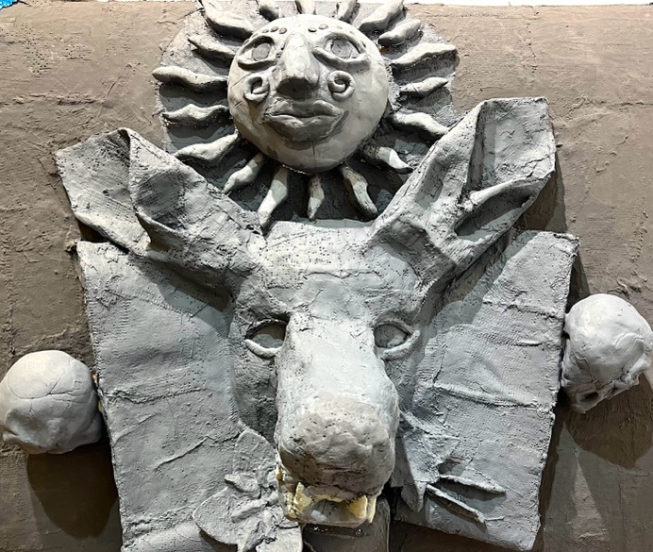
First Place - Emali Sanchez, 7th

Slide 39
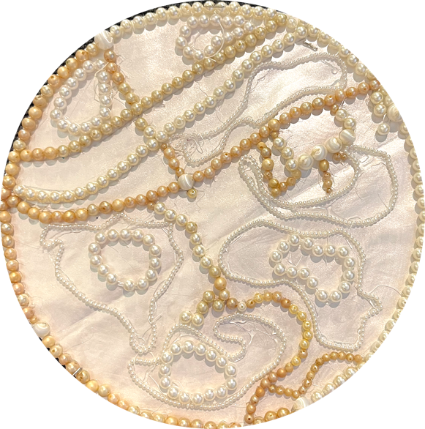
Second Place –Madison Bean, 7th

Slide 40
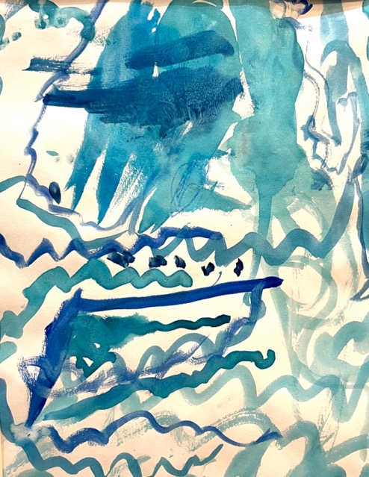
Honorable Mention –Brystal Wright, K

Slide 41
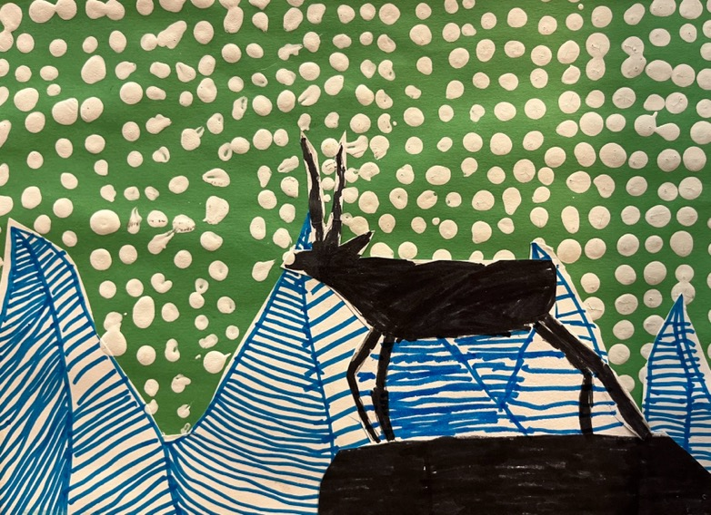
Honorable Mention –John Brady, 4th

Slide 42
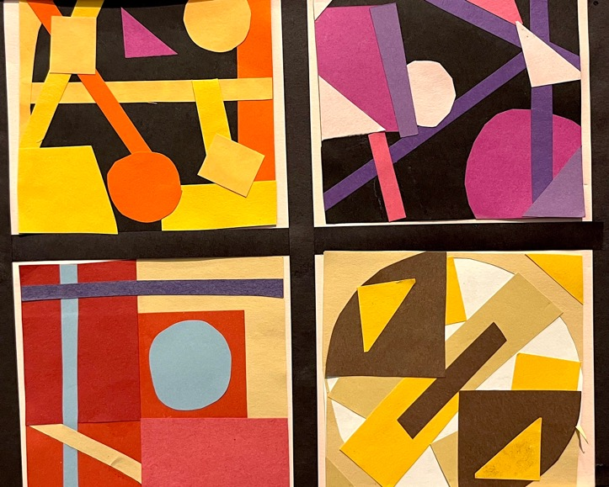
Honorable Mention –Angelina Ly, 6th Grade

Slide 43
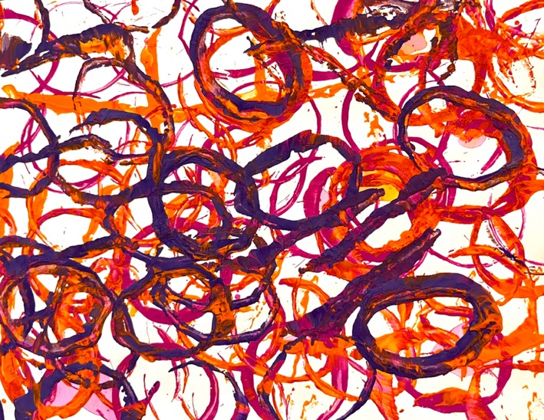
Honorable Mention –Briar Conseen, 1st grade

Slide 44
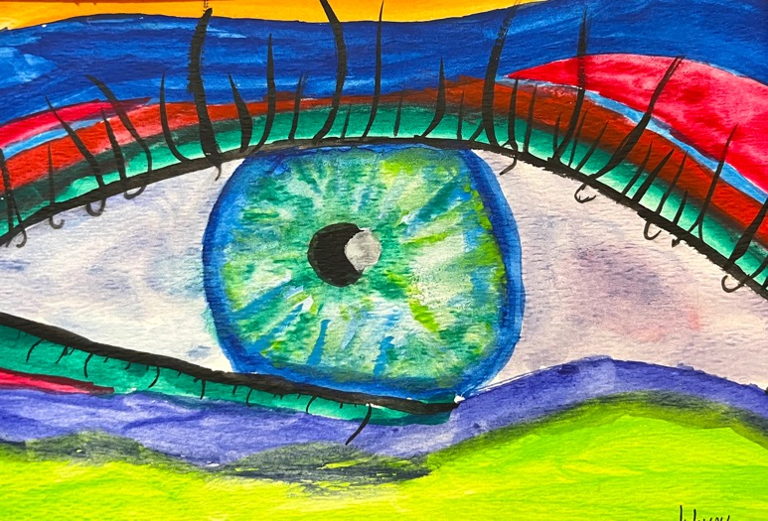
Honorable Mention- Aubrey Bodfield, 6th

Slide 45
Smoky Mountain High School
Art Teacher: Autumn Hall and Intern: Kathryn Barnett

Slide 46
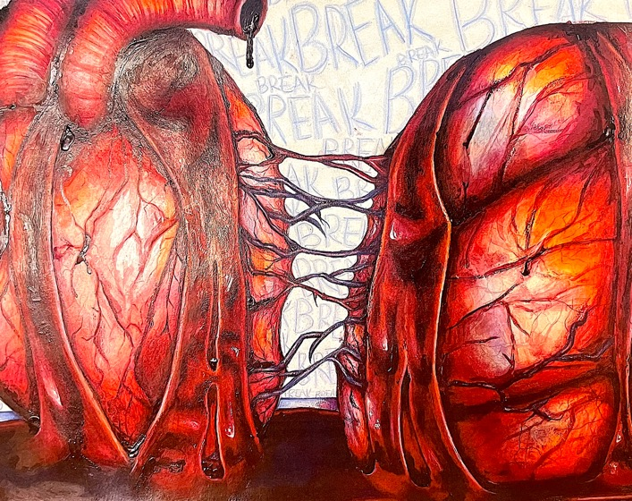
First Place –Emma Helsing, 12th

Slide 47
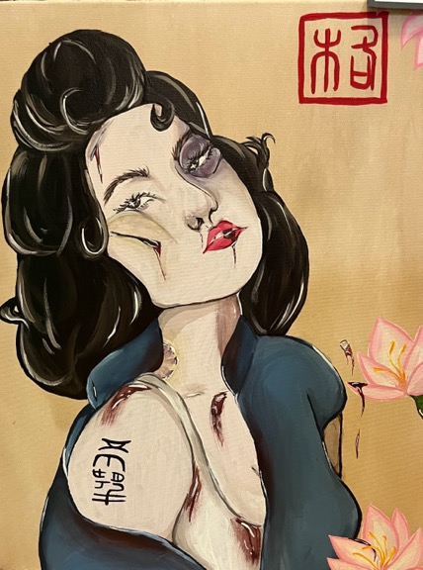
Second Place- Mary Georgia Grube, 12th

Slide 48
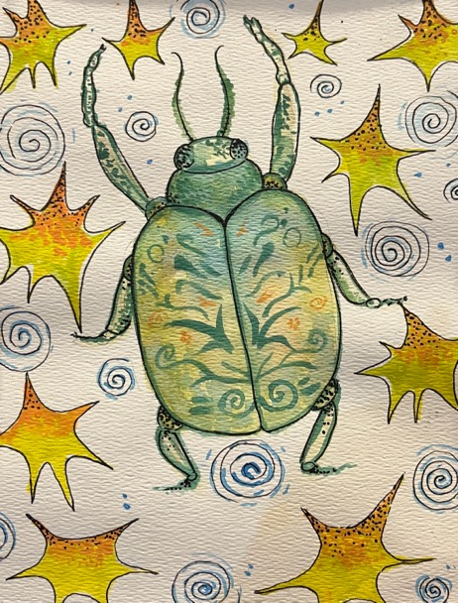
Honorable Mention-Bella Clonch, 10th

Slide 49
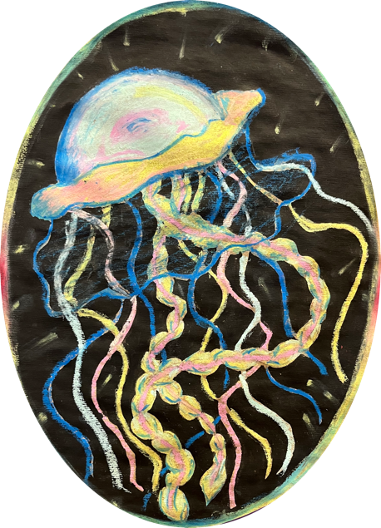
Honorable Mention –Kileyh Mitchell

Slide 50
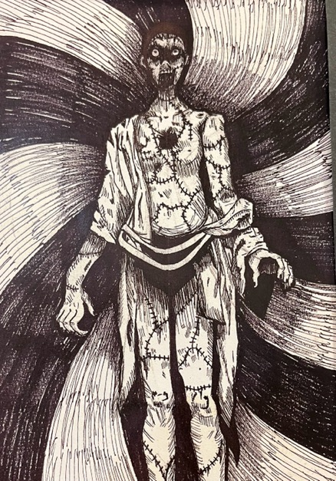
Honorable Mention –Juju Stanton, 12th

Slide 51
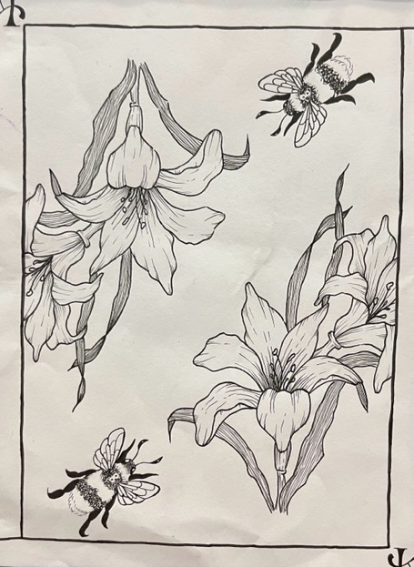
Honorable Mention –Kaytlin Helt, 11th

Slide 52
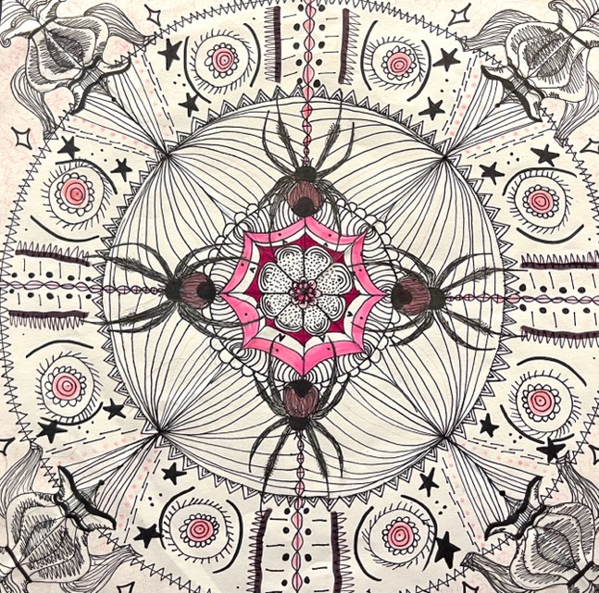
Honorable Mention –Aeryn O’Connell, 10th

Slide 53
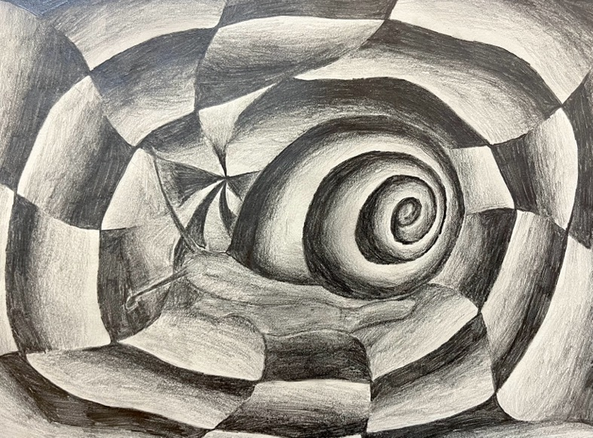
Honorable Mention –Lorelai McCoy, 12th

